Slide 1
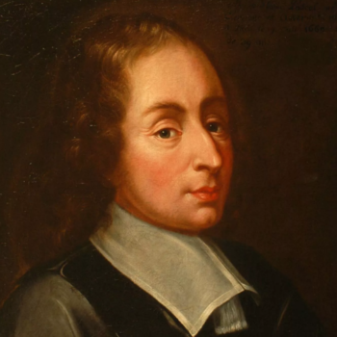
Жизнь Блеза Паскаля. Изобретение арифметической машины.
Гневнов Артем Евгеньевич, студент 2 курса, 2 группа, ИИТТО, РГПУ имени А.И. Генцена.

Slide 2
The Life of Blaise Pascal. Invention of the arithmetic machine.
Gnevnov Artem Evgenievich, 2nd year student, 2nd group, the Institute of Information Technology and Technology Education, Herzen University.

Slide 3
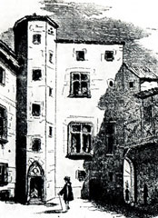
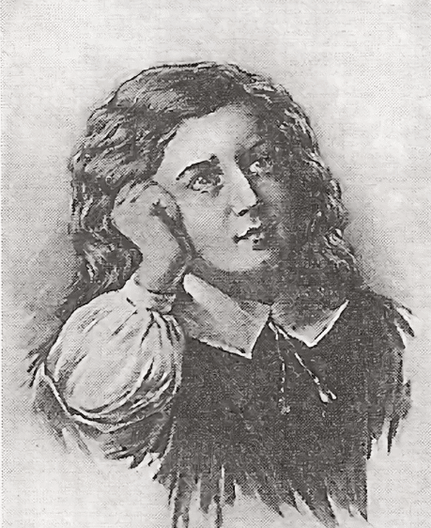
Early life
House of Pascals in Clermont-Ferrand
Young Blaise Pascal

Slide 4
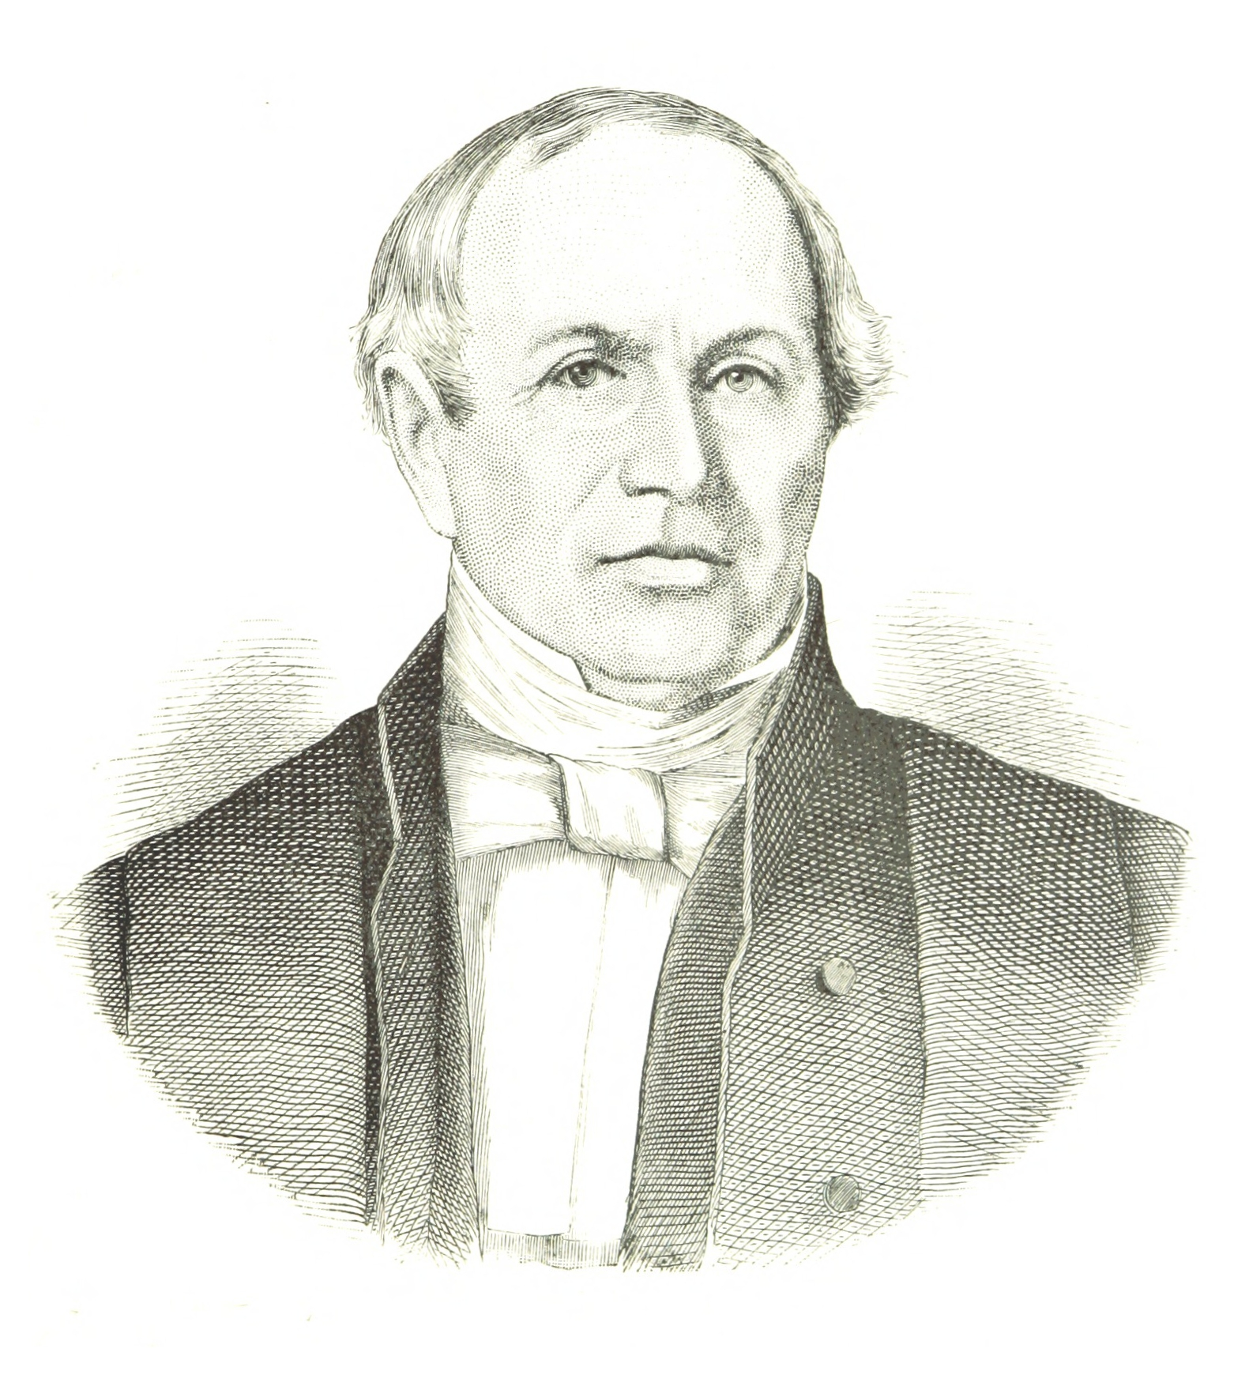
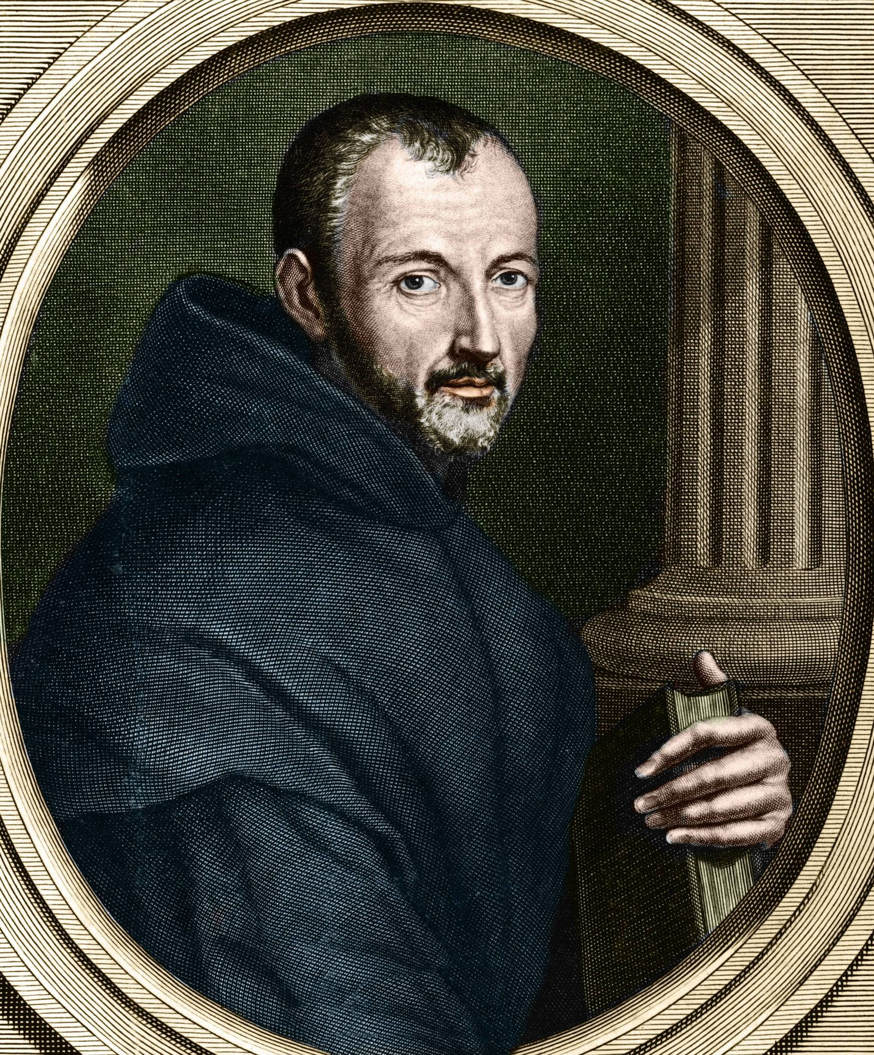
Education
Etienne Pascal, father of Blaise Pascal
Maren Mersenne, Pascal teacher

Slide 5
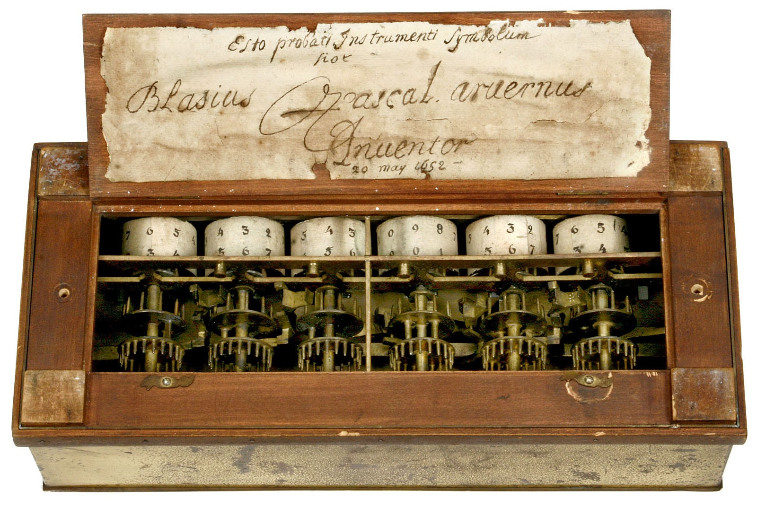
Pascal's arithmetic machine
Pascaline

Slide 6
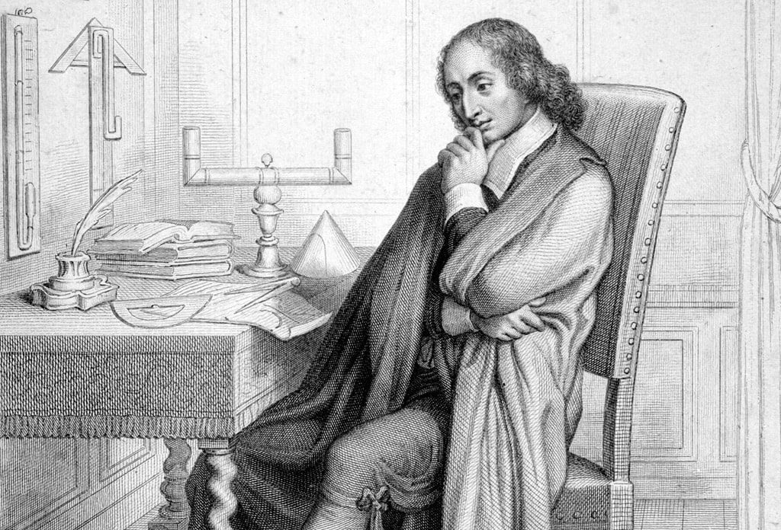
Personal life
Blaise Pascal at work

Slide 7
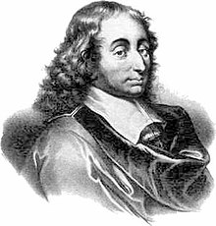
Death
August 19,1662

Slide 8
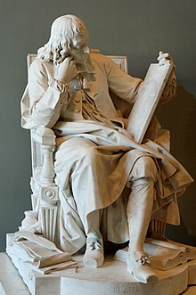

Legacy
Pascal Studying the Cycloid, Louvre
Pascal programming language

Slide 9
Thank you for attention!

Slide 10
Sources
1. https://biographe.ru/znamenitosti/blez-paskal/
2. https://nowimir.ru/DATA/030025_6_1.htm
3. https://bigenc.ru/c/mersenn-maren-aa1fab
4. https://spadilo.ru/biography/blez-paskal/

Slide 11
Questions
1. Who gave Blaise Pascal his primary education?
2. What is the name of Pascal's arithmetic machine?
3. In what sciences did Pascal make discoveries?
4. In what city was Pascal born?
5. Why was Pascal's arithmetic machine created?

